Slide 1


B.E. Project Review – Phase I
“A Deep Learning & Reinforcement Learning based Conversational AI Agent”
Internal Guide – Dr. Pradnya Kulkarni | External Guide – Mr. Asif Immanad
Ameya Mahabaleshwarkar
Mrunalini Kulkarni
Nachiket Sirsikar
Kunal Gadgil

Slide 2
Motivation
Conversational AI Agents like chatbots and voice assistants have proliferated due to –
Advancement in Natural Language Processing with the development of highly accurate Machine Learning and Deep Learning based models.
Progress in achieving higher computing power with the help of complex hardware architectures like GPUs and TPUs.
Conversational agents have been seen as a natural fit in a wide array of applications like healthcare, customer care, e-commerce, etc.
Easier deployment of AI applications with the help of cloud technologies.
This rise in research interest and practical implementation has made Conversational AI a ripe area for innovation and novel research

Slide 3
Objective
To develop a hybrid architecture that combines the latest innovations in the subdomains of NLP & Conversational AI i.e. Natural Language Understanding, Dialogue Management, Information Retrieval and Natural Language Generation
To integrate other AI capabilities like Visual/Text Q&A, Text Summarization, Image Segmentation etc.
To experiment with these methodologies in new domains where there has been less exploration and to document the results

Slide 4
Scope
Implementing and experimenting with Deep Learning and Reinforcement Learning algorithms for the Conversational AI use case.
Deploying the resulting model architecture in an easy to use interface like a mobile application or a web application.
Testing the architectures performance in different domains that heavily involve natural language interactions ex. Healthcare, etc., which is subject to the availability of appropriate datasets

Slide 5
Introduction
Conversational AI is a sub-domain of Artificial Intelligence that deals with speech-based or text-based AI agents that have the capability to simulate and automate conversations and verbal interactions.
The basic components of a Conversational AI architecture –
Natural Language Understanding
Dialogue Management
Natural Language Generation
Intelligent capabilities

Slide 6
Natural Language Understanding
Natural language understanding (NLU) is a branch of artificial intelligence (AI) that uses computers to understand input made in the form of unstructured text or speech.
Intent Classification
Intent Classification helps the bot understand what exactly is the desired goal or the objective of the user.
Entity Recognition
Named Entity Recognition deals with identifying and separating the named entities of a sentence into various predefined classes.

Slide 7
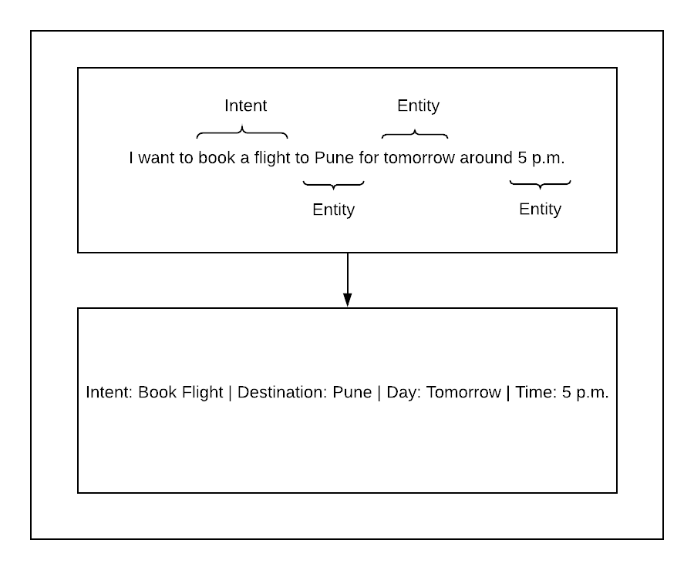

Slide 8
Literature Survey – Natural Language Understanding
Category | Model | Advantages / Disadvantages
Traditional | Regular Expressions | Limited scope
Intermediate | Traditional ML/DL (ex. SVMs) | Disregard semantic similarity
State of the Art | DL + Word Embeddings | Semantic relations preserved
References - [1] – [19]

Slide 9
Dialogue Management
Responsible for governing the actions of the Conversational Agent and mapping inputs to appropriate outputs and has been an area of tremendous research interest for the past two decades.
The DM system is responsible for developing an interaction strategy that can guide the agent in deciding its own actions based on the inputs that have been received from the user.
DM systems can be of two types viz. Goal/Task Oriented Systems and Non-Task Oriented Systems.

Slide 11
Literature Survey – Dialogue Management
Category | Model | Advantages / Disadvantages
Traditional | Switch statements / FSMs | Limited scope
Intermediate | Knowledge-based | Require large annotated data
State of the Art | Hybrid Architectures (DL+RL) | Require less training data
References - [20] – [35]

Slide 12
Natural Language Generation
Natural Language Generation (NLG) is a subdomain of NLP that is focused on the methods of response generation in natural language.
In the perspective of Conversational AI, NLG plays the important role of making the conversation seem more natural for the human participant which is a critical factor for judging the effectiveness of Conversational Agents.
The output from the NLG component in a Conversational Agent is a natural language sentence or text which is also the final output of the Conversational AI framework for each dialogue instance.

Slide 13
Literature Survey – Natural Language Generation
Category | Model | Advantages / Disadvantages
Traditional | Rule-based models | Limited scope
Intermediate | Seq2Seq | Largely affected by response distributions in training data
State of the Art | RL + Seq2Seq | Better diversity in responses
References – [36] – [46]

Slide 14
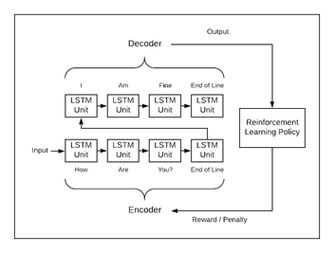

Slide 15
Methodology / Work Plan
Breadth-First approach
Spiral Model
Each phase will contain an increment in each of the components i.e. NLU, DM and NLG.

Slide 16
Progress
Review Paper
Pradnya K., Ameya M., Mrunalini K., Nachiket S., Kunal G., “Conversational AI: An Overview of Methodologies, Applications & Future Scope.”
Conference Presentation
5th IEEE International Conference on Computing, Communication, Control, and Automation.
Intent Classification Implementation
RL based Dialogue Management implementation
Text based Q&A implementation

Slide 17
References
[1] L. Qiu, Y. Chen, H. Jia and Z. Zhang, "Query Intent Recognition Based on Multi-Class Features," in IEEE Access, vol. 6, pp. 52195-52204, 2018.
[2] J. Chen, R. Prasad, S. Stoyanchev, E. Selfridge, S. Bangalore and M. Johnston, "Corpus and Annotation Towards NLU for Customer Ordering Dialogs," 2018 IEEE Spoken Language Technology Workshop (SLT), Athens, Greece, 2018, pp. 707-713.
[3] Razzaq M.A., Khan W.A., Lee S. (2017) Intent-Context Fusioning in Healthcare Dialogue-Based Systems Using JDL Model., Enhanced Quality of Life and Smart Living. ICOST 2017. Lecture Notes in Computer Science, vol 10461. Springer, Cham.
[4] X. Dong, L. Qian, Y. Guan, L. Huang, Q. Yu and J. Yang, "A multiclass classification method based on deep learning for named entity recognition in electronic medical records," 2016 New York Scientific Data Summit (NYSDS), New York, NY, 2016, pp. 1-10.
[5] J.Devlin, M.-W.Chang, K.Lee, K.Toutanova ,Bert: pre-training of deep bidirectional transformers for language understanding,arXiv:1810.04805.
[6] Young, S. (2017). Statistical Spoken Dialogue Systems and the Challenges for Machine Learning. Proceedings of the Tenth ACM International Conference on Web Search and Data Mining – WSDM’17.
[7] T. Young, D. Hazarika, S. Poria and E. Cambria, "Recent Trends in Deep Learning Based Natural Language Processing [Review Article]," in IEEE Computational Intelligence Magazine, vol. 13, no. 3, pp. 55-75, Aug. 2018.
[8] B. H. Juang and Tsuhan Chen, "The past, present, and future of speech processing," in IEEE Signal Processing Magazine, vol. 15, no. 3, pp. 2448, May 1998.

Slide 18
[9] M. C. Surabhi, "Natural language processing future," 2013 International Conference on Optical Imaging Sensor and Security (ICOSS), Coimbatore, 2013, pp. 1-3.
[10] Ek, T., Kirkegaard, C., Jonsson, H., & Nugues, P. (2011). Named Entity Recognition for Short Text Messages. Procedia - Social and Behavioral Sciences, 27, 178–187.
[11] A survey of named entity recognition and classification. (2007). Lingvisticæ Investigationes, 30(1), 3–26.
[12] McCallum, A., & Li, W. (2003). Early results for named entity recognition with conditional random fields, feature induction and web-enhanced lexicons. Proceedings of the Seventh Conference on Natural Language Learning at HLT-NAACL 2003.
[13] Dong, X., Qian, L., Guan, Y., Huang, L., Yu, Q., & Yang, J. (2016). A multiclass classification method based on deep learning for named entity recognition in electronic medical records. 2016 New York Scientific Data Summit (NYSDS).
[14] Zheng, Suncong, et al. “Joint Entity and Relation Extraction Based on a Hybrid Neural Network.” Neurocomputing, vol. 257, Sept. 2017, pp. 59– 66.
[15] H. Cuayahuitl, S. Renals, O. Lemon and H. Shimodaira, "Humancomputer dialogue simulation using hidden Markov models," IEEE Workshop on Automatic Speech Recognition and Understanding, 2005., San Juan, 2005, pp. 290-295.
[16] Mendoza M., Zamora J. (2009) Building Decision Trees to Identify the Intent of a User Query. In: Velásquez J.D., Ríos S.A., Howlett R.J., Jain L.C. (eds) Knowledge-Based and Intelligent Information and Engineering Systems. KES 2009. Lecture Notes in Computer Science, vol 5711. Springer, Berlin, Heidelberg.
[17] Zhang, T., Cho, J. H. D., & Zhai, C. (2014). Understanding user intents in online health forums. Proceedings of the 5th ACM Conference on Bioinformatics, Computational Biology, and Health Informatics - BCB ’14.
[18] Meng, Lian, and Minlie Huang. “Dialogue Intent Classification with Long Short-Term Memory Networks.” Natural Language Processing and Chinese Computing, edited by Xuanjing Huang et al., Springer International Publishing, 2018, pp. 42–50.
[19] L. Qiu, Y. Chen, H. Jia and Z. Zhang, "Query Intent Recognition Based on Multi-Class Features," in IEEE Access, vol. 6, pp. 52195-52204, 2018.

Slide 19
[20] Ilievski, V., Musat, C., Hossmann, A., and Baeriswyl, M. (2018). Goaloriented chatbot dialog management bootstrapping with transferlearning.arXiv preprint arXiv:1802.00500.
[21] Chen, H., Liu, X., Yin, D., & Tang, J. (2017). A Survey on Dialogue Systems. ACM SIGKDD Explorations Newsletter, 19(2), 25–35.
[22] Hussain, S., Ameri Sianaki, O., & Ababneh, N. (2019). A Survey on Conversational Agents/Chatbots Classification and Design Techniques. Developments in Primatology: Progress and Prospects, 946–956.
[23] Cranshaw, J., Elwany, E., Newman, T., Kocielnik, R.,Yu, B., Soni, S., Teevan, J., and Monroy-Hernandez, A.Calendar. help: Designing a workflow-based schedulingagent with humans in the loop. InProceedings of the2017 CHI Conference on Human Factors in ComputingSystems, ACM (2017), 2382–2393.
[24] Bhavika. R. R., Nidhi. R. and Sanjay. S., "Chatbot for university related FAQs," 2017 International Conference on Advances in Computing Communications and Informatics (ICACCI), Udupi, 2017, pp. 1525-1530Silvia.
[25] Q., Suresh M., A Chatbot-based Interactive Question Answering System, Proceedings of the 11th Workshop on the Semantics and Pragmatics of Dialogue, pages 83–90. Trento, Italy, 30 May – 1 June 2007.
[26] C. Liu et al., "Augmented LSTM Framework to Construct Medical SelfDiagnosis Android," 2016 IEEE 16th International Conference on Data Mining (ICDM), Barcelona, 2016, pp. 251-260.
[27] Traum D.R., Larsson S. (2003) The Information State Approach to Dialogue Management. In: van Kuppevelt J., Smith R.W. (eds) Current and New Directions in Discourse and Dialogue. Text, Speech and Language Technology, vol 22. Springer, Dordrecht.
[28] Zhu W., Chowanda A., Valstar M. (2016) Topic Switch Models for Dialogue Management in Virtual Humans. In: Traum D., Swartout W., Khooshabeh P., Kopp S., Scherer S., Leuski A. (eds) Intelligent Virtual Agents. IVA 2016. Lecture Notes in Computer Science, vol 10011. Springer, China.
[29] C. Hori, Kiyonori Ohtake, Teruhisa Misu, Hideki Kashioka and Satoshi Nakamura, "Statistical dialog management applied to WFST-based dialog systems," 2009 IEEE International Conference on Acoustics, Speech and Signal Processing, Taipei, 2009, pp. 4793-4796.
[30] Olivier Lemon, Olivier Pietquin. Machine Learning for Spoken Dialogue Systems. European Conference on Speech Communication and Technologies (Interspeech'07), Aug 2007, Anvers, Belgium. Pp.26852688.

Slide 20
[31] Mnih, V., Kavukcuoglu, K., Silver, D., Graves, A., Antonoglou, I., Wierstra, D., Riedmiller, M.: Playing atari with deep reinforcement learning. In: Proceedings of the NIPS Deep Learning Workshop (2013).
[32] Cuayáhuitl, H., Keizer, S., Lemon, O.: Strategic dialogue management via deep reinforcement learning. In: Proceedings of the NIPS Deep Reinforcement Learning Workshop (2015).
[33] Su, P.-H., Gasic, M., Mrksic, N., Rojas-Barahona, L., Ultes, S., Vandyke, D., Wen, T.-H., and Young,S. (2016a). Continuously Learning Neural Dialogue Management. ArXiv e-prints.
[34] Paek, T., & Pieraccini, R. (2008). Automating spoken dialogue management design using machine learning: An industry perspective. Speech Communication, 50(8-9), 716–729.
[35] S. Lei, X. Wang and C. Yuan, "Word-Based POMDP Dialog Management via Hybrid Learning," in IEEE Access, vol. 7, pp. 39236-39243, 2019.
[36] Albert. G., Emiel. K., Survey of the State of the Art in Natural Language. Generation: Core tasks, applications and evaluation, Journal of Artificial Intelligence Research 61 (2018) 65-170.
[37] Gervás. P., Díaz-Agudo. B., Peinado. F., & Hervás. R. (n.d.). Story Plot Generation based on CBR. Applications and Innovations in Intelligent Systems XII, 33–46.
[38] Deemter, K. van, Theune, M., & Krahmer, E. (2005). Real versus Template-Based Natural Language Generation: A False Opposition? Computational Linguistics, 31(1), 15–24.
[39] Ratnaparkhi. A., (2000) Trainable methods for surface natural language generation. In Proceedings of the 6th Applied Natural Language Processing Conference and the 1st Meeting of the North American Chapter of the Association of Computational Linguistics (ANLPNAACL'00), pp. 194–201.
[40] Wen. T-H., Gasic. M., Kim. D., Mrksic. N., Su. P-H., Vandyke. D., and Young. S. 2015a. Stochastic Language Generation in Dialogue using Recurrent Neural Networks with Convolutional Sentence Re-ranking. In Proceedings of the16th Annual Meeting of the Special Interest Group on Discourse and Dialogue (SIGDIAL). Association for Computational Linguistics, September.
[41] Wen. T-H., Gasic. M., Kim. D., Mrksic. N., Su. P-H., Vandyke. D., and Young. S., 2015b. Semantically conditioned lstm-based natural language generation for spoken dialogue systems. In Proceedings of the 2015 Conference on Empirical Methods in Natural Language Processing (EMNLP). Association for Computational Linguistics, September.

Slide 21
[42] Ji. Z., Xiong. K., Pang. Y., & Li. X. (2019). Video Summarization with Attention-Based Encoder-Decoder Networks. IEEE Transactions on Circuits and Systems for Video Technology, 1–1.
[43] M. Qiu, F.-L. Li, S. Wang, X. Gao, Y. Chen, W. Zhao,H. Chen, J. Huang, and W. Chu. Alime chat: A se-quence to sequence and rerank based chatbot engine.InProceedings of the 55th Annual Meeting of the Association for Computational Linguistics (Volume 2:Short Papers), volume 2, pages 498–503, 2017.
[44] J. Li, X. Chen, E.H. Hovy, D. Jurafsky, Visualizing and understanding neural models in NLP, CoRR abs/1506 (2015) 01066.
[45] Y. Keneshloo, T. Shi, C. K Reddy, and N. Ramakrishnan. 2018. Deep Reinforcement Learning for Sequence to Sequence Models. arXiv preprint arXiv:1805.09461(2018).
[46] Shibata T., Egashira Y., Kurohashi S. (2016) Chat-Like Conversational System Based on Selection of Reply Generating Module with Reinforcement Learning. In: Situated Dialog in Speech-Based HumanComputer Interaction. Signals and Communication Technology. Springer, Cham.

